Slide 1
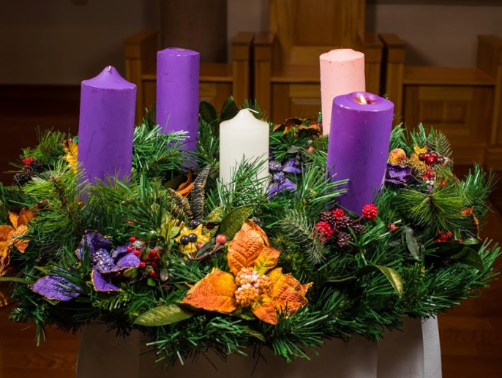
Advent Sunday
29th November 2020
at 11.00am (UK)
Churn Valley Benefice
Cirencester Deanery
Online Worship

Slide 2
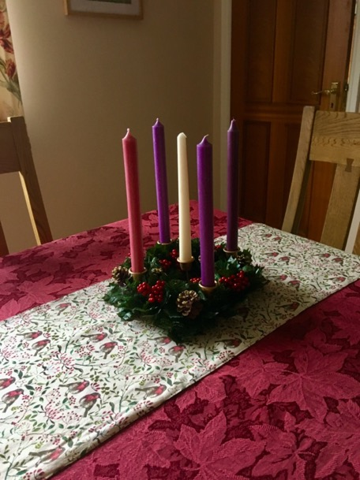
Order of service
Welcome
Introduction
Lighting the Advent Wreath
Advent Carol
The Collect
Isaiah 64: 1 - 9 read by Gill Clark
Mark 13: 24 – 37 read by Sylvie Pierce
Address by Dr Ben Newton
Passing of the bread
Prayers
Closing exhortation
Advent Carol
Dismissal with Blessing

Slide 3
LIGHTING THE ADVENT WREATH
As the first candle is lit:
The first candle is to remind us of the Advent hope that Christ will come again in glory at the end of time; and will come afresh into our hearts this Christmas.
Now is the time to wake out of sleep: for now our salvation is nearer than when we first believed
We say together:
God as you came to those who have gone before us so you come to us now in Jesus. Help us to recognise your presence in our neighbours and to care as well for them as we do for ourselves.
Amen

Slide 4
LIGHTING THE ADVENT WREATH
As the first candle is lit:
The first candle is to remind us of the Advent hope that Christ will come again in glory at the end of time; and will come afresh into our hearts this Christmas.
Now is the time to wake out of sleep: for now our salvation is nearer than when we first believed
We say together:
God as you came to those who have gone before us so you come to us now in Jesus. Help us to recognise your presence in our neighbours and to care as well for them as we do for ourselves.
Amen

Slide 5
ADVENT CAROL
O come, O come Emmanuel
sung by St Martin’s Voices
1 O come, O come Emmanuel, redeem thy captive Israel, that into exile drear is gone, far from the face of God’s dear son. Rejoice! Rejoice! Emmanuel shall come to thee, O Israel. 2 O come, thou branch of Jesse, draw the quarry from the lion's claw;
from the dread caverns of the grave,
from nether hell, thy people save. Refrain
3 O come, O come, thou Dayspring bright.
Pour on our souls thy healing light;
dispel the long night's lingering gloom,
and pierce the shadows of the tomb.
Refrain 4 O Come, thou Lord of David’s Key.
The royal door fling wide and free;
safeguard for us the heavenward road,
and bar the way to death's abode.
Refrain 5 O come, O come, Adonai,
who in thy glorious majesty
from that high mountain clothed in awe,
gavest thy folk the elder Law.
Refrain
Latin 13th century, translated by T. A. Lacey (1853-1931)
© Oxford University Press

Slide 6
THE COLLECT
Almighty God,
give us grace to cast away the works of darkness
and to put on the armour of light, now in the time of this mortal life,
in which your Son Jesus Christ came to us in great humility;
that on the last day, when he shall come again in his glorious majesty
to judge the living and the dead, we may rise to the life immortal;
through him who is alive and reigns with you,
in the unity of the Holy Spirit, one God, now and for ever.
Amen

Slide 7
BIBLE READING – Isaiah 64: 1 - 9
O that you would tear open the heavens and come down, so that the mountains would quake at your presence— ² as when fire kindles brushwood and the fire causes water to boil— to make your name known to your adversaries, so that the nations might tremble at your presence! ³ When you did awesome deeds that we did not expect, you came down, the mountains quaked at your presence. ⁴ From ages past no one has heard, no ear has perceived, no eye has seen any God besides you, who works for those who wait for him. ⁵ You meet those who gladly do right, those who remember you in your ways. But you were angry, and we sinned; because you hid yourself we transgressed.^{[b]}
⁶ We have all become like one who is unclean, and all our righteous deeds are like a filthy cloth. We all fade like a leaf, and our iniquities, like the wind, take us away. ⁷ There is no one who calls on your name, or attempts to take hold of you; for you have hidden your face from us, and have delivered^{[c]} us into the hand of our iniquity. ⁸ Yet, O Lord, you are our Father; we are the clay, and you are our potter; we are all the work of your hand. ⁹ Do not be exceedingly angry, O Lord, and do not remember iniquity forever. Now consider, we are all your people.

Slide 8
Mark 13: 24 - 37
things have taken place. ³¹ Heaven and earth will pass away, but my words will not pass away. ³² “But about that day or hour no one knows, neither the angels in heaven, nor the Son, but only the Father. ³³ Beware, keep alert; for you do not know when the time will come. ³⁴ It is like a man going on a journey, when he leaves home and puts his slaves in charge, each with his work, and commands the doorkeeper to be on the watch. ³⁵ Therefore, keep awake—for you do not know when the master of the house will come, in the evening, or at midnight, or at cockcrow, or at dawn, ³⁶ or else he may find you asleep when he comes suddenly. ³⁷ And what I say to you I say to all: Keep awake.”
²⁴ “But in those days, after that suffering,
the sun will be darkened, and the moon will not give its light, ²⁵ and the stars will be falling from heaven, and the powers in the heavens will be shaken.
²⁶ Then they will see ‘the Son of Man coming in clouds’ with great power and glory. ²⁷ Then he will send out the angels, and gather his elect from the four winds, from the ends of the earth to the ends of heaven.
²⁸ “From the fig tree learn its lesson: as soon as its branch becomes tender and puts forth its leaves, you know that summer is near. ²⁹ So also, when you see these things taking place, you know that he^{[a]} is near, at the very gates. ³⁰ Truly I tell you, this generation will not pass away until all these

Slide 9
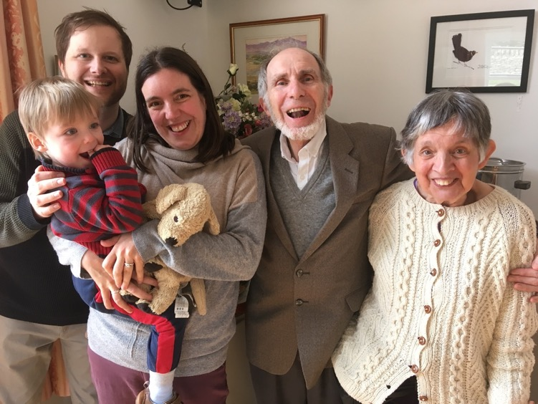
ADDRESS BY DR BEN NEWTON

Slide 10
PASSING OF THE BREAD
Grace
Be present at our table, Lord;
Be here and everywhere adored;
Thy creatures bless, and grant that we
May feast in paradise with Thee.
(John Cenick)
The bread is passed from person to person with the option of quoting this verse of scripture:
“…Let us love one another, for love comes from God.” (1 John 4: 7)
Father of earth and heaven,
Thy hungry children feed,
Thy grace be to our spirits given,
That true immortal bread.
Grant us and all our race
In Jesus Christ to prove
The sweetness of thy pardoning grace,
The manna of thy love.
(attributed to Charles Wesley)

Slide 11
PRAYERS
Everlasting God,
As we come before you at the start of the Season of Advent, we ask you to prepare us for the coming, of your son Jesus Christ and to hear us when we pray in faith for the needs of the Church
and the world as well as to thank you for your goodness.
(short silence)
Lord in your mercy:
hear our prayer
Mighty God,
We pray for your church today, gathering worldwide in buildings large and small as well as outdoors and online to praise you and to hear your holy word.
Give us a sense of expectation as we come and inspiration as we go.
Give wisdom to the Bishop’s senior staff as they decide which of their team members will be made redundant since the pandemic has caused such a big drop of income to the Diocese of Gloucester.
We pray especially for our own clergy and lay readers here in the Churn Valley Benefice as the team seeks to do your by guiding us the Advent journey,
until the day when we celebrate together the birth of your Son the Saviour of the world.
(short silence)
Lord in your mercy:
hear our prayer

Slide 12
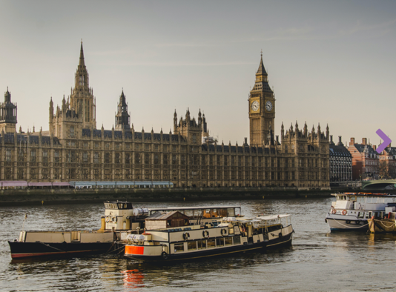
Creator God,
Drive away despair from our politics, revive our dream of justice and truth, and restore our passion for what is good and right.
Establish your just and gentle rule throughout the world especially where there is conflict; thinking especially of Ethiopia, where peace seems so far away and so many have lost everything, even the faint hope of a peaceful future.
Govern the hearts and minds of all leaders of nations that they may act justly, love mercy and walk humbly with you the Living God.
We pray too for a safe and effective vaccine that will give allow us to have a better year ahead.
(short silence)
Lord in your mercy:
hear our prayer

Slide 13
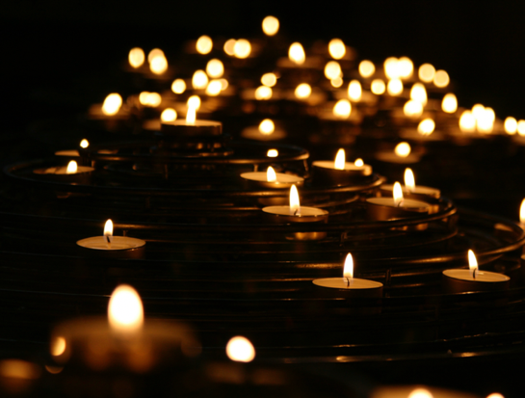
Father God
We pray for those amongst our families, friends and neighbours who will only see in Advent a hectic and worrying run up to the excesses of a secular Christmas.
Help us as we try to set an example of a true spirit of preparation for that incredibly precious gift of the Christ-child.
May those around us come to appreciate through joining us in worship the true meaning of Christmas and experience your love for them through the giving of your Son, Jesus Christ
For our Prayers: those known to us suffering with Covid-19 especially Michael Dykes’ sons and their families as well as my brother John and his wife Lillian. Also, those who mourn such as the Milroy family and Jenny See.
(short silence)
Lord in your mercy:
hear our prayer

Slide 14
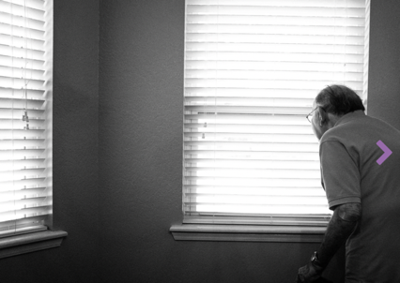
Merciful God
We pray for those for whom this day will be long and painful, for those in hospital or ill at home, those struggling with despair or depression and for all who care for them.
Comfort and heal all who suffer, give them courage and hope in their troubles, and bring them the joy of your salvation.
(short silence)
Lord in your mercy:
hear our prayer

Slide 15
Loving God
We pray for those who have recently died and for those for whom this day will be their last.
Be near to all who mourn and comfort them with the knowledge that in the coming of your son Jesus the gates of heaven will be opened wide for all who accept him as Lord and Saviour.
Years Mind: Julia Fisher, George Malfait, Cynthia Hughes, Barbara Gardener,
David Mulcock, James Ricalton, Bob Mason, The Hon Lady Winifred Murray, Dilys Walters.
Those who have died: Mike Appleby, Christopher Matthews, Andrea Shutt, Frederick Russell.
(short silence)
Lord in your mercy:
hear our prayer

Slide 16
Lord of Advent,
As we come to the end of this morning’s worship, please draw near to us, strengthen our faith, deepen our love for you and for our neighbours and open our eyes to the wonder of your creation, so that when our Saviour comes he may find our hearts ready to receive him.
Merciful Father:
accept these prayers
for the sake of your Son
our Saviour Jesus Christ
Amen

Slide 17
CLOSING EXHORTATION
“In the tender mercy of our God, the dayspring from on high shall break upon us, to give light to those who dwell in darkness and in the shadow of death, and to guide our feet into the way of peace”.
Luke 1: 78-79

Slide 18
ADVENT CAROL
Lo, he comes with clouds descending
sung by St Martin’s Voices
1 Lo, he comes with clouds descending, once for favoured sinners slain; thousand thousand saints attending swell the triumph of his train: alleluia! alleluia! alleluia! God appears on earth to reign.
2 Every eye shall now behold him robed in dreadful majesty; those who set at naught and sold him, pierced and nailed him to the tree, deeply wailing, deeply wailing, deeply wailing, shall the true Messiah see.
3 Those dear tokens of his passion still his dazzling body bears; cause of endless exultation to his ransomed worshippers: with what rapture, with what rapture,
with what rapture, gaze we on those glorious scars.
Yea, amen, let all adore thee, high on thine eternal throne; Saviour, take the power and glory, claim the kingdom for thine own: O come quickly, O come quickly, O come quickly, alleluia! come, Lord, come!
Charles Wesley (1707-1788), Martin Madan (1726-1790),
John Cennick (1718-1755)

Slide 19
DISMISSAL WITH BLESSING
Christ the sun of Righteousness shine upon us
and scatter the darkness from before our path.
And the blessing of the Living God
the Father, Son and Holy Spirit,
Be among us and remain with us always
All - Amen.

Slide 20
