Slide 1
Commemoration of the Faithful Departed (All Souls’ Day)
1st November 2020 at 7.00pm
Churn Valley Benefice
Cirencester Deanery
Reflections and Prayers
Online Worship

Slide 2
The Greeting
Grace, mercy and peace
from God our Father
and the Lord Jesus Christ
be with you
All and also with you.
Prayers of Penitence
God has shone in our hearts
to give the light of the knowledge of his glory
in the face of Christ.
But we have this treasure in earthen vessels
to show that the transcendent power belongs to Godand not to us.
As we acknowledge our human frailty,
we call to mind our sins of word, deed and omission,
and confess them before God our Father.

Slide 3
All Father eternal, giver of light and grace,
we have sinned against you and against our neighbour,
in what we have thought,
in what we have said and done,
through ignorance, through weakness,
through our own deliberate fault.
We have wounded your love,
and marred your image in us.
We are sorry and ashamed,
and repent of all our sins.
For the sake of your Son Jesus Christ,
who died for us,
forgive us all that is past;
and lead us out from darkness
to walk as children of light.
Amen.

Slide 4
Almighty God,
who forgives all who truly repent,
have mercy upon you,
pardon and deliver you from all your sins,
confirm and strengthen you in all goodness,
and keep you in life eternal;
through Jesus Christ our Lord.
All Amen.

Slide 5
Let us pray for the peace and well-being of the whole Church.
Silence is kept.
Everlasting God, our maker and redeemer,
grant us, with all the faithful departed,
the sure benefits of your Son’s saving passion and glorious resurrection,
that, in the last day,
when you gather up all things in Christ,
we may with them enjoy the fullness of your promises;
through Jesus Christ your Son our Lord,
who is alive and reigns with you,
in the unity of the Holy Spirit,
one God, now and for ever.
All Amen.

Slide 6
Revelation 7: 9 – end
⁹ After this I looked, and there before me was a great multitude that no one could count, from every nation, tribe, people and language, standing before the throne and before the Lamb. They were wearing white robes and were holding palm branches in their hands. ¹⁰ And they cried out in a loud voice:
“Salvation belongs to our God, who sits on the throne, and to the Lamb.”
¹¹ All the angels were standing around the throne and around the elders and the four living creatures. They fell down on their faces before the throne and worshiped God,¹² saying:
“Amen!

Slide 7
Praise and glory and wisdom and thanks and honour and power and strength be to our God for ever and ever. Amen!”
¹³ Then one of the elders asked me, “These in white robes—who are they, and where did they come from?”
¹⁴ I answered, “Sir, you know.”
And he said, “These are they who have come out of the great tribulation; they have washed their robes and made them white in the blood of the Lamb. ¹⁵ Therefore,
“they are before the throne of God and serve him day and night in his temple; and he who sits on the throne will shelter them with his presence.

Slide 8
¹⁶ ‘Never again will they hunger; never again will they thirst. The sun will not beat down on them,’ nor any scorching heat. ¹⁷ For the Lamb at the center of the throne will be their shepherd; ‘he will lead them to springs of living water.’ ‘And God will wipe away every tear from their eyes.’”

Slide 9
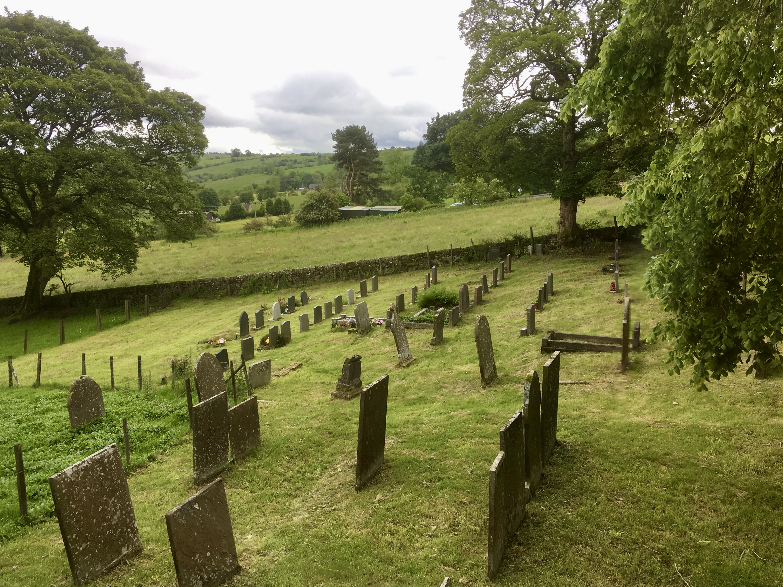
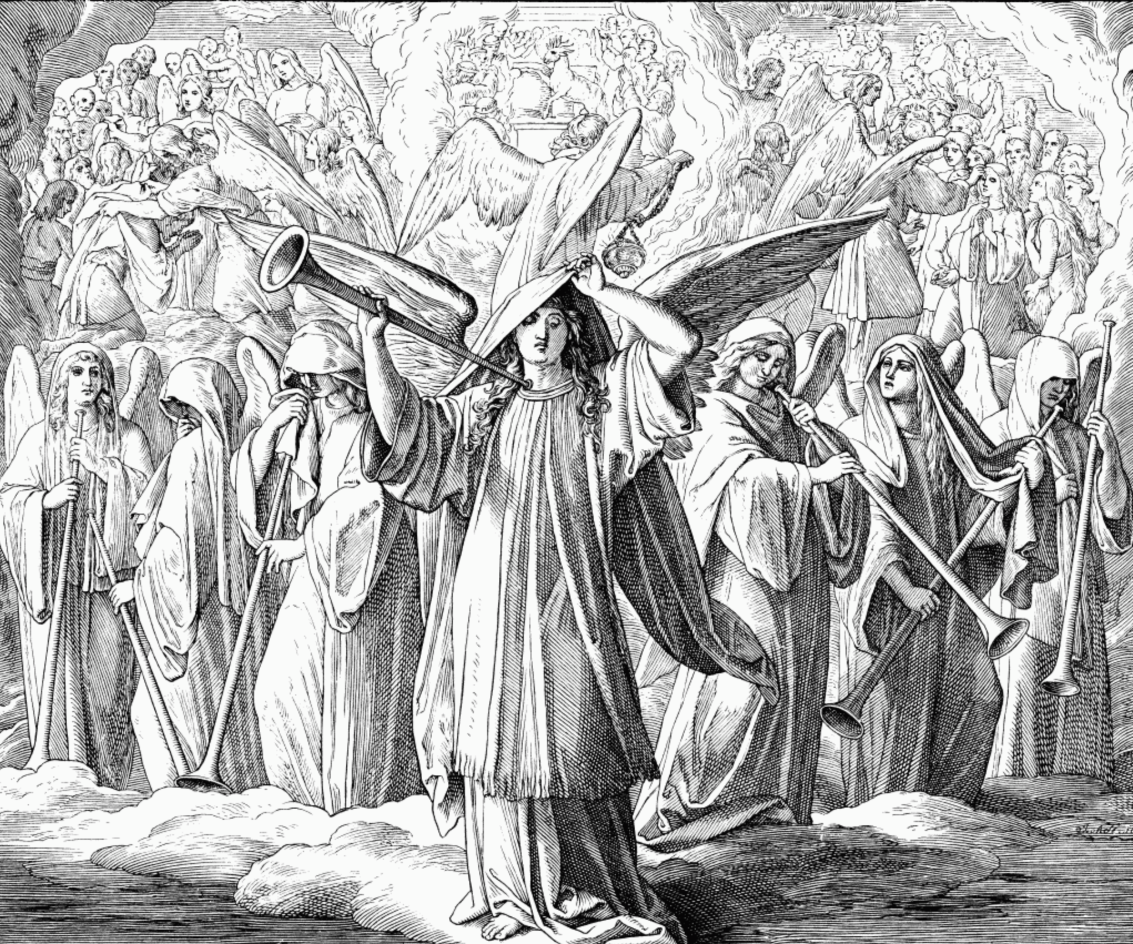
Reflections
“144,000 with Trumpets”, 1860 woodcut by Julius Schnorr von Karosfeld

Slide 10
Hymn
For all the saints who from their labours rest, who thee by faith before the world confessed, thy name, O Jesus, be forever blest. Alleluia! Alleluia!
Thou wast their rock, their fortress, and their might; thou, Lord, their captain in the well-fought fight; thou, in the darkness drear, their one true light. Alleluia! Alleluia!
O blest communion, fellowship divine, we feebly struggle, they in glory shine; yet all are one in thee, for all are thine. Alleluia! Alleluia!

Slide 11
But lo! there breaks a yet more glorious day; the saints triumphant rise in bright array; the King of glory passes on his way. Alleluia! Alleluia!
From earth's wide bounds, from ocean's farthest coast, through gates of pearl streams in the countless host, singing to Father, Son, and Holy Ghost, Alleluia! Alleluia!

Slide 12
Prayers
You are worthy, our Lord and God,
to receive glory and honour and power.
All For you have created all things,
and by your will they have their being.
You are worthy, O Lamb, for you were slain,
and by your blood you ransomed for God
saints from every tribe and language and nation.
All You have made them to be a kingdom and priests
serving our God,
and they will reign with you on Earth.
The names of those to be remembered may be read aloud.

Slide 13
This is the will of him that sent me,
that I should lose nothing of all that he has given me,
All and I will raise them up at the last day.
Lord God, creator of all,
you have made us creatures of this earth,
but have also promised us a share in life eternal.
According to your promises,
may all who have died in the peace of Christ
come with your saints to the joys of your kingdom,
where there will be neither sorrow nor pain,
but life everlasting.
All Alleluia. Amen.

Slide 14
Grant to us, Lord God,
to trust you not for ourselves alone,
but for those also whom we love
and who are hidden from us by the shadow of death;
that, as we believe your power to have raised our Lord Jesus Christ
from the dead,
so may we trust your love
to give eternal life to all who believe in him;
through Jesus Christ our Lord,
who is alive and reigns with you and the Holy Spirit,
one God, now and for ever.
All Amen.

Slide 15
