Slide 1
18th Sunday after Trinity
11th October 2020 at 7.00pm
Churn Valley Benefice
Cirencester Deanery
Reflections and Prayers
Online Worship

Slide 2
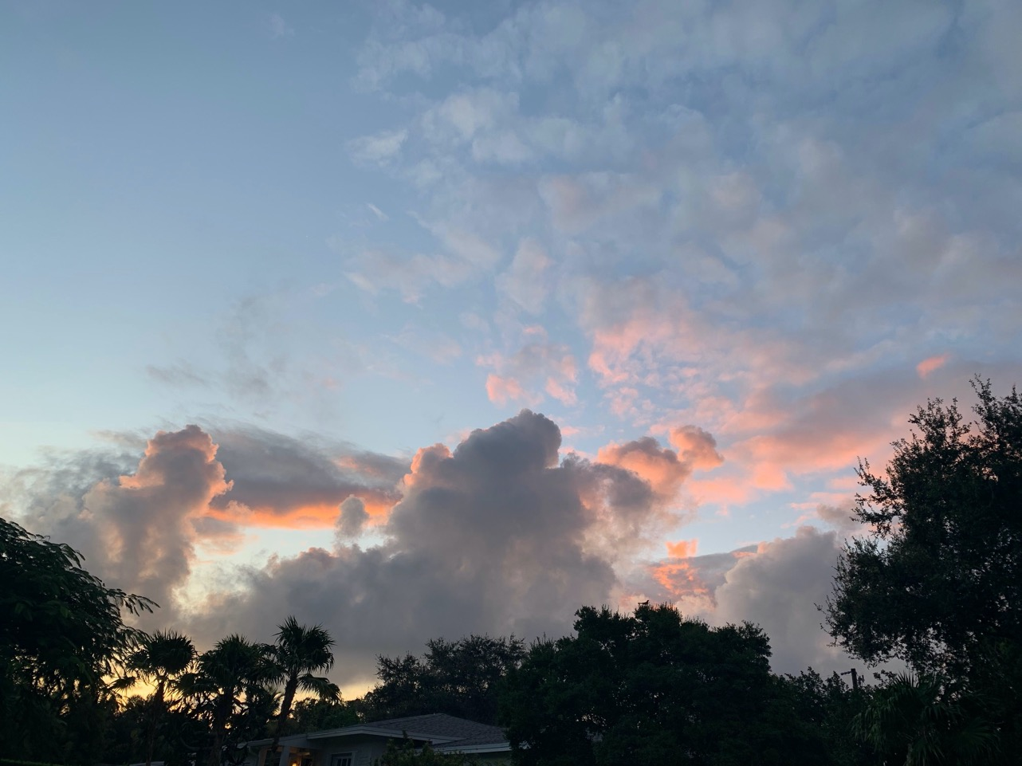
Sunrise in Miami this morning by Kitty Morgan

Slide 3
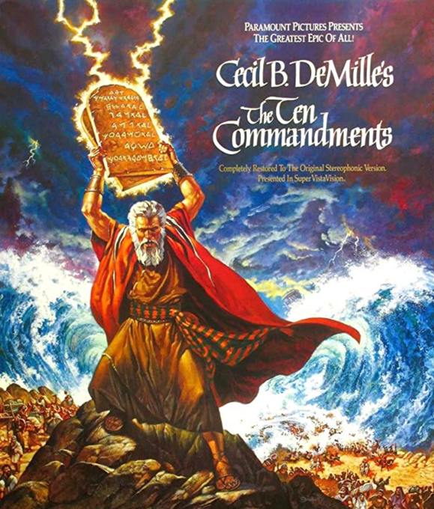

Slide 4
Preparation
O God, make speed to save us
All - O Lord, make haste to help us.
That this evening may be holy, good and peaceful, let us pray with one heart and mind.
Silence is kept.
As our evening prayer rises before you, O God, so may your mercy come down upon us to cleanse our hearts and set us free to sing your praise now and for ever. All - Amen.

Slide 5
Exodus 32: 1 - 14
32 When the people saw that Moses delayed to come down from the mountain, the people gathered around Aaron, and said to him, “Come, make gods for us, who shall go before us; as for this Moses, the man who brought us up out of the land of Egypt, we do not know what has become of him.” ² Aaron said to them, “Take off the gold rings that are on the ears of your wives, your sons, and your daughters, and bring them to me.” ³ So all the people took off the gold rings from their ears, and brought them to Aaron. ⁴ He took the gold from them, formed it in a mould, and cast an image of a calf; and they said, “These are your gods, O Israel, who brought you up out of the land of Egypt!”

Slide 6
⁵ When Aaron saw this, he built an altar before it; and Aaron made proclamation and said, “Tomorrow shall be a festival to the Lord.” ⁶ They rose early the next day, and offered burnt offerings and brought sacrifices of well-being; and the people sat down to eat and drink, and rose up to revel.
⁷ The Lord said to Moses, “Go down at once! Your people, whom you brought up out of the land of Egypt, have acted perversely; ⁸ they have been quick to turn aside from the way that I commanded them; they have cast for themselves an image of a calf, and have worshiped it and sacrificed to it, and said, ‘These are your gods, O Israel, who brought you up out of the land of Egypt!’” ⁹ The Lord said to Moses, “I have seen this people, how stiff-necked they are. ¹⁰ Now let me alone, so that my wrath may burn hot against them and I may consume them; and of you I will make a great nation.”

Slide 7
¹¹ But Moses implored the Lord his God, and said, “O Lord, why does your wrath burn hot against your people, whom you brought out of the land of Egypt with great power and with a mighty hand? ¹² Why should the Egyptians say, ‘It was with evil intent that he brought them out to kill them in the mountains, and to consume them from the face of the earth’? Turn from your fierce wrath; change your mind and do not bring disaster on your people. ¹³ Remember Abraham, Isaac, and Israel, your servants, how you swore to them by your own self, saying to them, ‘I will multiply your descendants like the stars of heaven, and all this land that I have promised I will give to your descendants, and they shall inherit it forever.’” ¹⁴ And the Lord changed his mind about the disaster that he planned to bring on his people.
This is the word of the Lord
All – Thanks be to God

Slide 8
³² “Do not be afraid, little flock, for your Father has been pleased to give you the kingdom.³³ Sell your possessions and give to the poor. Provide purses for yourselves that will not wear out, a treasure in heaven that will never fail, where no thief comes near and no moth destroys. ³⁴ For where your treasure is, there your heart will be also.

Slide 9
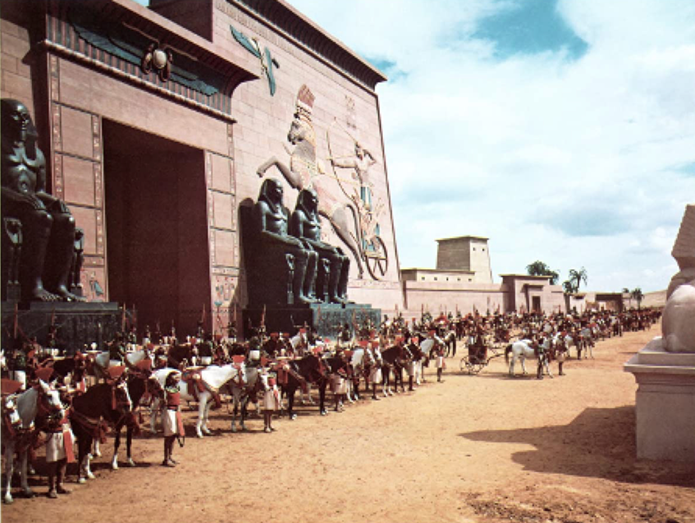
Short reflection

Slide 10
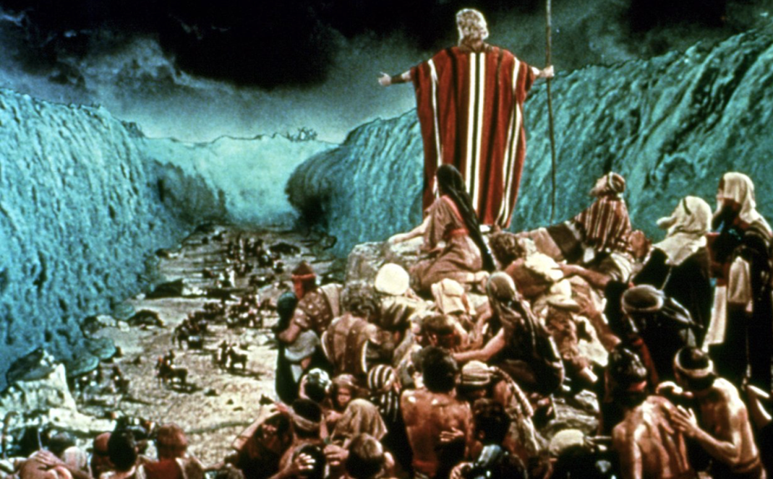

Slide 11
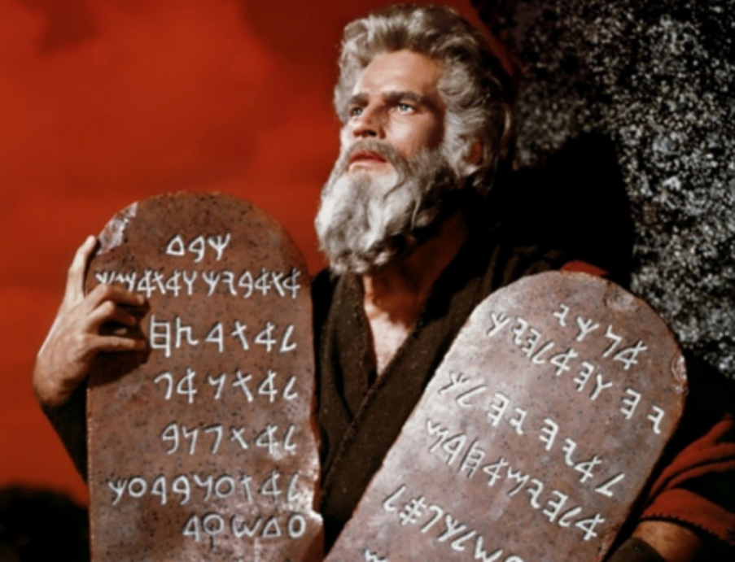

Slide 12
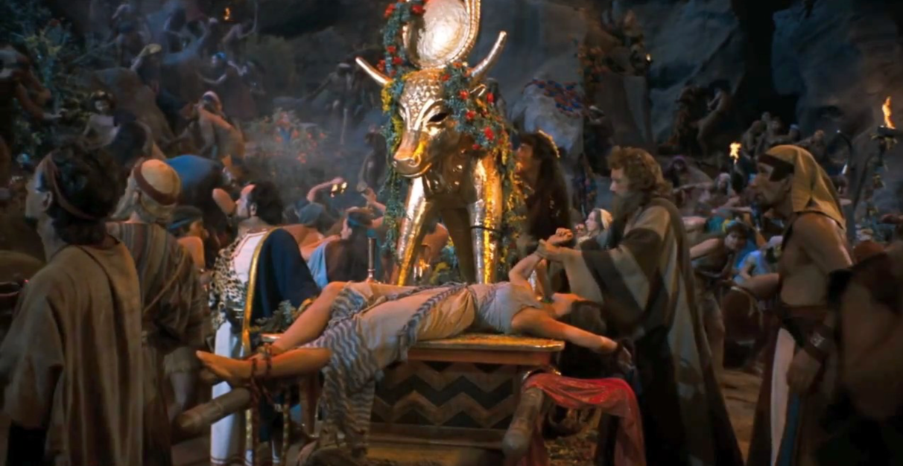

Slide 14
HYMN – Dear Lord and Father of Mankind
Dear Lord and Father of mankind, forgive our foolish ways: reclothe us in our rightful mind; in purer lives your service find, in deeper reverence praise, in deeper reverence praise.
In simple trust like theirs who heard, beside the Syrian sea, the gracious calling of the Lord let us, like them, obey his word: 'Rise up and follow me, rise up and follow me!'

Slide 15
O sabbath rest by Galilee! O calm of hills above, when Jesus shared on bended knee the silence of eternity interpreted by love, interpreted by love!
Drop your still dews of quietness, till all our strivings cease; take from our souls the strain and stress, and let our ordered lives confess the beauty of your peace, the beauty of your peace.

Slide 16
Breathe through the heats of our desire your coolness and your balm; let sense be dumb, let flesh retire, speak through the earthquake, wind and fire, O still small voice of calm, O still small voice of calm!

Slide 17
Prayers
Please join in at the end of each brief prayer
Lord, in your mercy,
All - Hear our Prayer.

Slide 18
The Lord’s Prayer
Our Father, who art in heaven,
Hallowed be thy Name,
Thy Kingdom come,
Thy will be done on Earth as it is in heaven,
Give us this day our daily bread,
And forgive us our trespasses,
As we forgive those who trespass against us,
And lead us not into temptation,
But deliver us from evil,
For thine is the kingdom,
And the power, and the glory,
For ever and ever,
Amen

Slide 19
