Slide 1
Trinity 9
9th August 2020 at 9.30am
Churn Valley Benefice, Cirencester Deanery
Reflections and Prayers
Online Worship

Slide 2
Preparation
O Lord, open our lips All - and our mouth shall proclaim your praise.
Jesus said; “Blessed are the peacemakers, for they will be called children of God.”
We are called to be peacemakers, to stand against injustice, inequality and oppression For injustice anywhere is a threat to justice everywhere.
Let us gather, as the children of God, committed to the call to peace-making. We gather, as the children of God, the God of peace is our refuge.

Slide 3
The night has passed, and the day lies open before us;
let us pray with one heart and mind.
Silence is kept
As we rejoice in the gift of this new day,
so may the light of your presence, O God,
set our hearts on fire with love for you;
now and forever,
All - Amen

Slide 4
Bible reading
Micah 4: 1-4
¹ In the last days the mountain of the Lord’s temple will be established as the highest of the mountains; it will be exalted above the hills, and peoples will stream to it.
² Many nations will come and say,
“Come, let us go up to the mountain of the Lord, to the temple of the God of Jacob. He will teach us his ways, so that we may walk in his paths.”

Slide 5
³ He will judge between many peoples and will settle disputes for strong nations far and wide. They will beat their swords into ploughshares and their spears into pruning hooks. Nation will not take up sword against nation, nor will they train for war anymore.
⁴ Everyone will sit under their own vine and under their own fig tree, and no one will make them afraid, for the Lord Almighty has spoken
a time of silence

Slide 6
REFLECTION
Revd Canon Dr Henry Jansma, former APF Chair
Canon Theologian at Missionary Diocese of
CANA East, Greater Philadelphia Area

Slide 7
Prayers of Confession
God of peace, for choosing to put our trust in weapons of war: We come before you in sorrow and confession.
God of Life, for our silent complicity with the industry of death: We come before you in sorrow and confession.
God of generosity, for supporting the arms trade through our work or our taxes, or for profiting from it through our shares and investments. We come before you in sorrow and confession.

Slide 8
God of hope, for our doubts and despair in the face of evil. We come before you in sorrow and confession. God of courage, for our fear to speak out of to take bold action. We come before you in sorrow and confession. Amen
Absolution
If we have confessed then God has forgiven,
from now on we can be new people in him.
Thanks be to God.
Amen

Slide 9
Hymn – “For the healing of the nations”
For the healing of the nations,
Lord, we pray with one accord;
for a just and equal sharing
of the things that Earth affords.
To a life of love in action
help us rise and pledge our word.
Lead us, Father, into freedom,
from despair your world release;
that, redeemed from war and hatred,
all may come and go in peace.
Show us how through care and goodness
fear will die and hope increase.

Slide 10
All that kills abundant living,
let it from the Earth be banned;
pride of status, race or schooling,
dogmas that obscure your plan.
In our common quest for justice
may we hallow life’s brief span.
You, creator God, have written
your great name on humankind;
for our growing in your likeness
bring the life of Christ to mind;
that by our response and service
Earth its destiny may find.
Fred Kaan

Slide 11
The Prayers
God of the prophets, God of Christ:
we are reminded today that your blessings do not necessarily follow the logic of the world.
The world believes that the rich are blessed, but Jesus reminds us that it is the poor who are blessed,
the poor in spirit and the materially poor as well. We pray for a more just world in which all have enough and none are left behind
silence

Slide 12
Jesus tells us that those who mourn are blessed. Help us to experience the truth of this mystery; bring healing and wholeness to those who are sick,
including any known to us and comfort those who have lost loved ones.
silence
While people covet power, guide us, O Lord, in the ways of humility; help us to stand in solidarity with the oppressed and marginalized; show us your presence in the faces of those the world forgets.
Give us a hunger and thirst for righteousness; fill our hearts with love, overflowing with mercy; make our hearts pure, and give us a vision of your glory.
silence

Slide 13
In a society divided by race, gender, class, ideology, sexual orientation, and so many other labels we alone have created,
remind us that we are created in your image, each of us a beautiful reflection of you, each of us your beloved child.
Help us then to end our conflicts and wars, help us to be peacemakers and agents of reconciliation.
silence
Merciful Father
accept these prayers
for the sake of your Son,
our Saviour,
Jesus Christ.
All Amen

Slide 14
The Lord’s Prayer
Our Father, who art in heaven,
Hallowed be thy Name,
Thy Kingdom come,
Thy will be done,
On Earth as it is in heaven,
Give us this day our daily bread,
And forgive us our trespasses,
As we forgive those who trespass against us,
And lead us not into temptation,
But deliver us from evil,
For thine is the kingdom,
And the power, and the glory,
For ever and ever,
All Amen

Slide 15
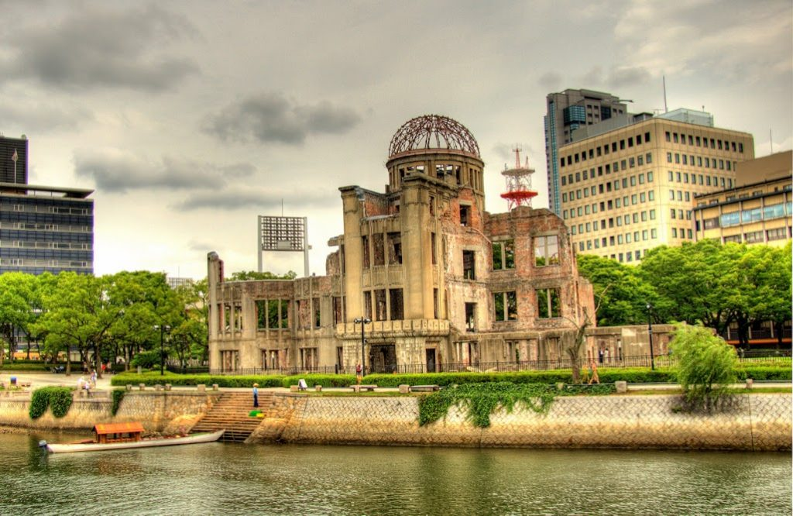
The Blessing
photo by Lucy Barbour, APF Trustee

