Slide 1
Trinity 5
12th July 2020 at 9.30am
Churn Valley Benefice, Cirencester Deanery
Reflections and Prayers
Online Worship

Slide 2
Preparation
O Lord, open our lips
All - and our mouth shall proclaim your praise.
The Benedicite (a Song of Creation)
1 Bless the Lord all you works of the Lord: ♦
sing his praise and exalt him for ever.
2 Bless the Lord you heavens: ♦
sing his praise and exalt him for ever.
3 Bless the Lord you angels of the Lord: ♦
sing his praise and exalt him for ever.
4 Bless the Lord all people on Earth: ♦
sing his praise and exalt him for ever.

Slide 3
5 O people of God bless the Lord: ♦
sing his praise and exalt him for ever.
6 Bless the Lord you priests of the Lord: ♦
sing his praise and exalt him for ever.
7 Bless the Lord you servants of the Lord: ♦
sing his praise and exalt him for ever.
8 Bless the Lord all you of upright spirit: ♦
bless the Lord you that are holy and humble in heart.
The Song of the Three 35-37, 60-65
All Bless the Father, the Son and the Holy Spirit: ♦
sing his praise and exalt him for ever.

Slide 4
The night has passed, and the day lies open before us;
let us pray with one heart and mind.
Silence is kept
As we rejoice in the gift of this new day,
so may the light of your presence, O God,
set our hearts on fire with love for you;
now and forever,
All - Amen

Slide 5
Word of God
Gen 25: 19 - end
These are the descendants of Isaac, Abraham’s son: Abraham was the father of Isaac, and Isaac was forty years old when he married Rebekah, daughter of Bethuel the Aramean of Paddan-aram, sister of Laban the Aramean. Isaac prayed to the Lord for his wife, because she was barren; and the Lord granted his prayer, and his wife Rebekah conceived. The children struggled together within her; and she said, ‘If it is to be this way, why do I live?’ So she went to inquire of the Lord. And the Lord said to her,
‘Two nations are in your womb,
and two peoples born of you shall be divided;
one shall be stronger than the other,
the elder shall serve the younger.’
When her time to give birth was at hand, there were twins in her womb. The first came out red, all his body like a hairy mantle; so they named him Esau. Afterwards his brother came out, with his hand gripping Esau’s heel; so he was named Jacob. Isaac was sixty years old when she bore them.
When the boys grew up, Esau was a skilful hunter, a man of the field, while Jacob was a quiet man, living in tents. Isaac loved Esau, because he was fond of game; but Rebekah loved Jacob.
Once when Jacob was cooking a stew, Esau came in from the field, and he was famished. Esau said to Jacob, ‘Let me eat some of that red stuff, for I am famished!’ (Therefore he was called Edom.) Jacob said, ‘First sell me your birthright.’ Esau said, ‘I am about to die; of what use is a birthright to me?’ Jacob said, ‘Swear to me first.’ So he swore to him, and sold his birthright to Jacob. Then Jacob gave Esau bread and lentil stew, and he ate and drank, and rose and went his way. Thus Esau despised his birthright.
a time of silence

Slide 6
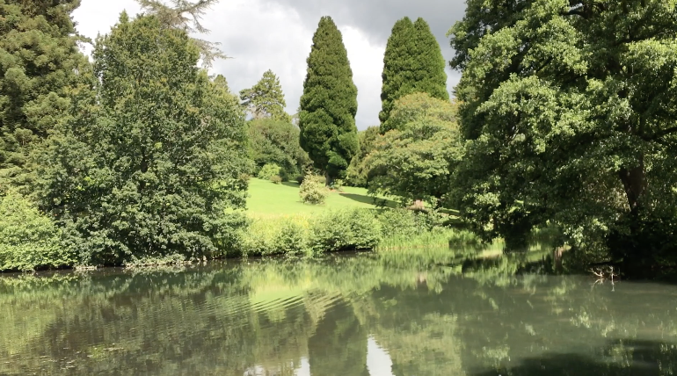
Reflection

Slide 7
HYMN
To God be the glory, great things He hath done,
So loved He the world that He gave us His Son,
Who yielded His life our redemption to win,
And opened the life-gate that all may go in.
Praise the Lord, praise the Lord, Let the Earth hear His voice;
Praise the Lord, praise the Lord, Let the people rejoice;
Oh, come to the Father, through Jesus the Son,
And give Him the glory; great things He hath done.
Oh, perfect redemption, the purchase of blood,
To every believer the promise of God;
The vilest offender who truly believes,
That moment from Jesus forgiveness receives.
Great things He hath taught us, great things He hath done,
And great our rejoicing through Jesus the Son;
But purer, and higher, and greater will be
Our wonder, our transport when Jesus we see.

Slide 8
The Lord’s Prayer
Our Father, who art in heaven,
Hallowed be thy Name,
Thy Kingdom come,
Thy will be done,
On earth as it is in heaven,
Give us this day our daily bread,
And forgive us our trespasses,
As we forgive those who trespass against us,
And lead us not into temptation,
But deliver us from evil,
For thine is the kingdom,
And the power, and the glory,
For ever and ever,
All Amen

Slide 9
The Blessing

