Slide 1
Sunday after Ascension Day
24th May 2020 at 9.30am
The parish church of St Giles, Coberley
Reflections and Prayers
Online Worship

Slide 2
Preparation
O Lord, open our lips All - and our mouth shall proclaim your praise.
Send your Holy Spirit upon us, All – and clothe us with power from on high
Alleluia.

Slide 3
A prayer of thanksgiving
Blessed are you, creator God,
to you be glory and praise for ever.
As your Spirit moved over the face of the waters
bringing light and life to your creation,
pour out your Spirit on us today
that we may walk as children of light
and by your grace reveal your presence.
Blessed be God, Father, Son and Holy Spirit.
All Blessed be God for ever.

Slide 4
The night has passed, and the day lies open before us;
let us pray with one heart and mind.
Silence is kept
As we rejoice in the gift of this new day,
so may the light of your presence, O God,
set our hearts on fire with love for you;
now and forever,
All - Amen

Slide 5
Word of God
Psalm 47
¹ Clap your hands, all you peoples; shout to God with loud songs of joy. ² For the Lord, the Most High, is awesome, a great king over all the earth. ³ He subdued peoples under us, and nations under our feet. ⁴ He chose our heritage for us, the pride of Jacob whom he loves.
⁵ God has gone up with a shout, the Lord with the sound of a trumpet. ⁶ Sing praises to God, sing praises; sing praises to our King, sing praises.

Slide 6
⁷ For God is the king of all the earth; sing praises with a psalm.^{[a]}
⁸ God is king over the nations; God sits on his holy throne. ⁹ The princes of the peoples gather as the people of the God of Abraham. For the shields of the earth belong to God; he is highly exalted.
Glory to the Father,
and to the Son and to the Holy Spirit.
As it was in the beginning,
is now and evermore shall be
All Amen
a time of silence

Slide 7
Acts 1: 1-11 NRSV
The Promise of the Holy Spirit
1 In the first book, Theophilus, I wrote about all that Jesus did and taught from the beginning ² until the day when he was taken up to heaven, after giving instructions through the Holy Spirit to the apostles whom he had chosen. ³ After his suffering he presented himself alive to them by many convincing proofs, appearing to them during forty days and speaking about the kingdom of God. ⁴ While staying^{[a]} with them, he ordered them not to leave Jerusalem, but to wait there for the promise of the Father. “This,” he said, “is what you have heard from me; ⁵ for John baptized with water, but you will be baptized with^{[b]} the Holy Spirit not many days from now.”

Slide 8
The Ascension of Jesus
⁶ So when they had come together, they asked him, “Lord, is this the time when you will restore the kingdom to Israel?” ⁷ He replied, “It is not for you to know the times or periods that the Father has set by his own authority. ⁸ But you will receive power when the Holy Spirit has come upon you; and you will be my witnesses in Jerusalem, in all Judea and Samaria, and to the ends of the earth.” ⁹ When he had said this, as they were watching, he was lifted up, and a cloud took him out of their sight. ¹⁰ While he was going and they were gazing up toward heaven, suddenly two men in white robes stood by them. ¹¹ They said, “Men of Galilee, why do you stand looking up toward heaven? This Jesus, who has been taken up from you into heaven, will come in the same way as you saw him go into heaven.”
a time of silence

Slide 9
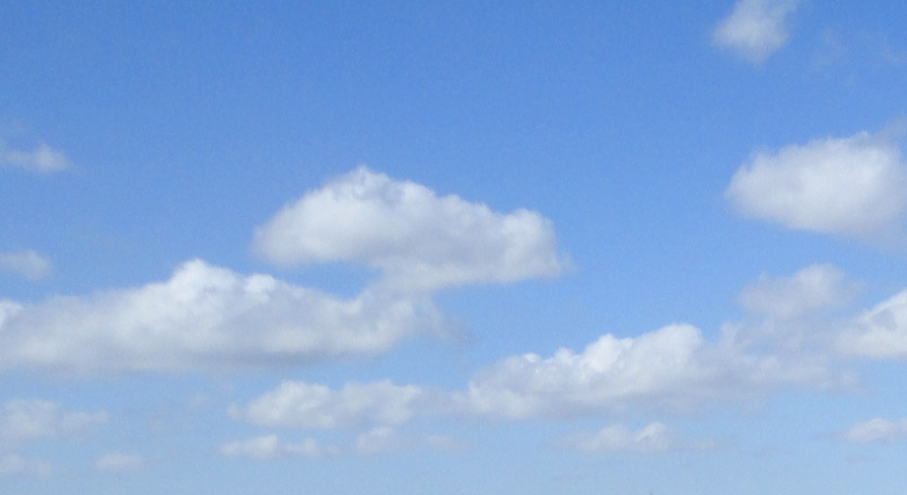
Reflection

Slide 10
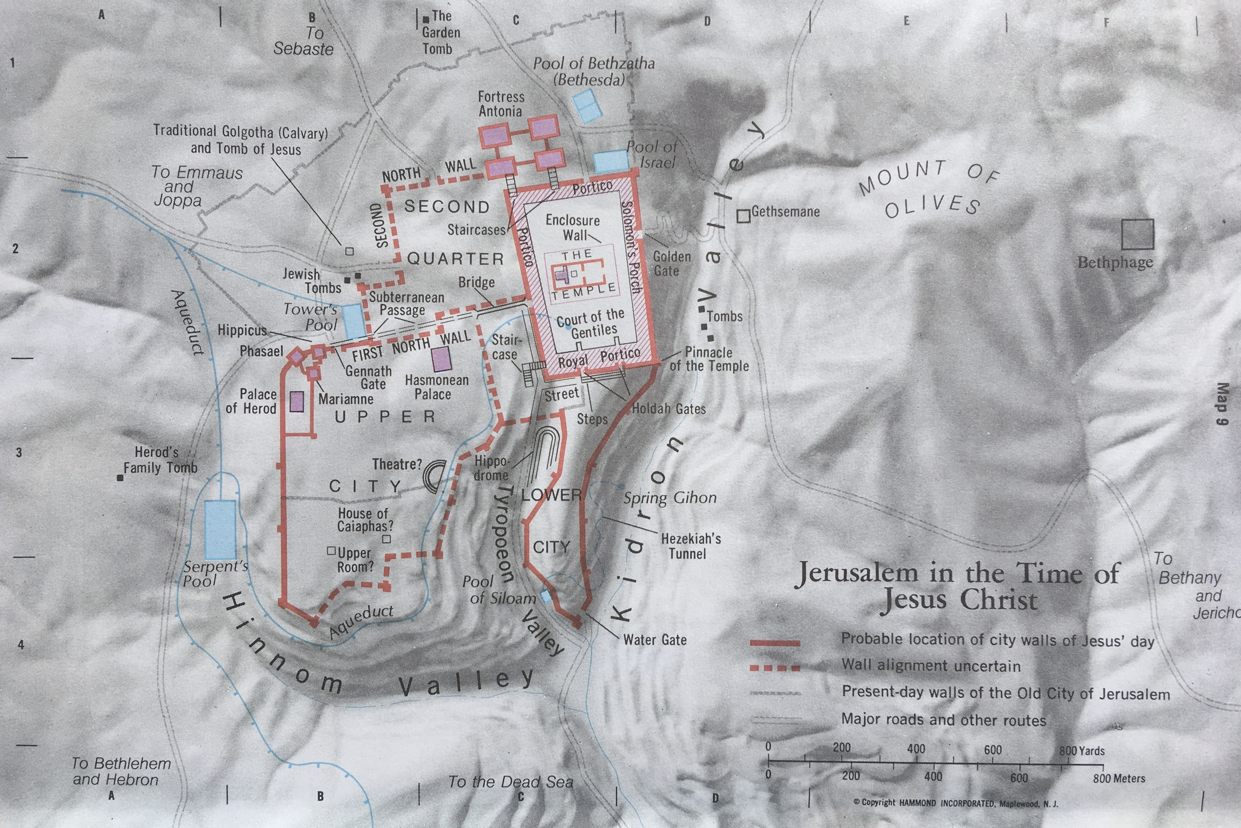

Slide 11
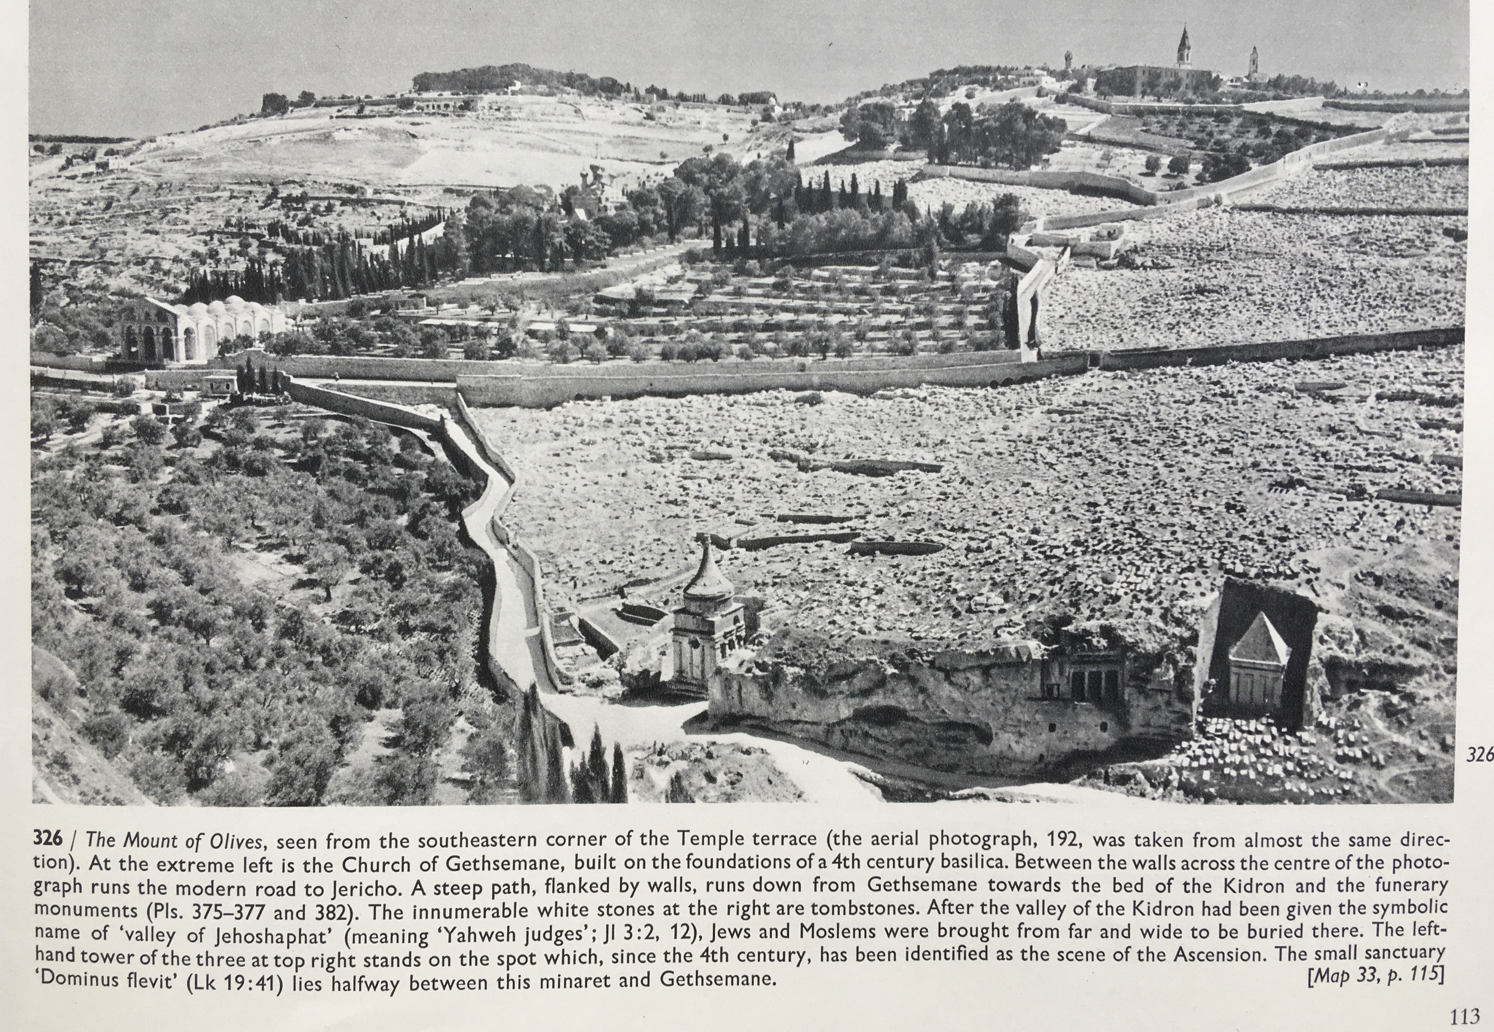

Slide 13
The Prayers
The Collect
O God the King of glory,
you have exalted your only Son Jesus Christ
with great triumph to your kingdom in heaven:
we beseech you, leave us not comfortless,
and send your Holy Spirit to strengthen us and
exalt us to the place where our Saviour Christ is gone before,
who is alive and reigns with you,
in the unity of the Holy Spirit,
one God, now and for ever.
All Amen

Slide 14
Let us pray to God,
who alone makes us dwell in safety:
For all who are affected by coronavirus,
through illness or isolation or anxiety,
that they may find relief and recovery:
Lord, hear us,
Lord, graciously hear us.
For those who are guiding our nation at this time,
and shaping national policies,
that they may make wise decisions:
Lord, hear us,
Lord, graciously hear us.

Slide 15
For doctors, nurses and medical researchers,
that through their skill and insights
many will be restored to health:
Lord, hear us,
Lord, graciously hear us.
For the vulnerable and the fearful,
for the gravely ill and the dying,
that they may know your comfort and peace:
Lord, hear us,
Lord, graciously hear us.
We commend ourselves, and all for whom we pray,
to the mercy and protection of God.
Merciful Father,
accept these prayers for the sake of your Son, our Saviour Jesus Christ.
All Amen

Slide 16
The Lord’s Prayer
Our Father, who art in heaven,
Hallowed be thy Name,
Thy Kingdom come,
Thy will be done,
On earth as it is in heaven,
Give us this day our daily bread,
And forgive us our trespasses,
As we forgive those who trespass against us,
And lead us not into temptation,
But deliver us from evil,
For thine is the kingdom,
And the power, and the glory,
For ever and ever,
All Amen

Slide 17
The Blessing

